Slide 1
Configuration Tool
First MVP efforts

Slide 2
Agenda
Introduction
MVP: What has been done?
Live Demo
Next Steps

Slide 3
What has been done?
Feature | Not Started | Concept | First Prototype | Stable Prototype
Artifact Creation
Dependency Creation
SWING User Interface
Content Specification
Visualize Dependencies
Validation: Integrity
Validation: Completeness
Validation: Correctness
Validation: Consistency
Validation Reporting

Slide 4
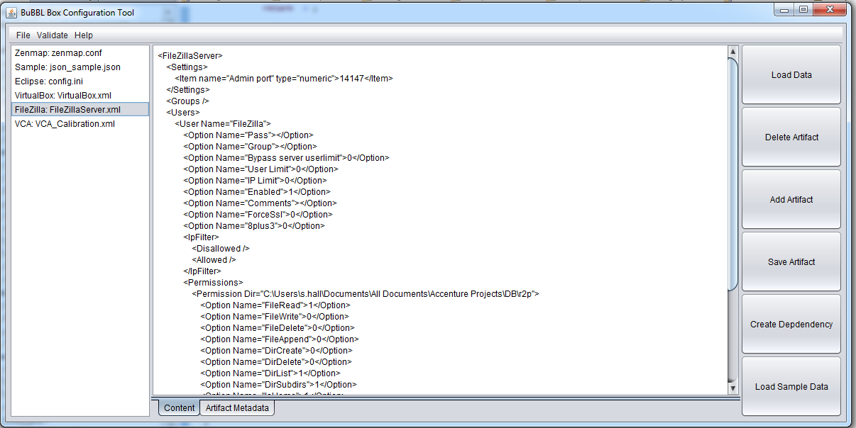
Live Demo

Slide 5
Next Steps
Feedback on MVP
Progressing the venture

